Slide 1

Milk and dairy products management system
DHARSHINI R
SANDHIYA DEVI B
SHRI SUBIKSHA S T

Slide 2
CONTENTS
INTRODUCTION
PROBLEM STATEMENT
SYSTEM REQUIREMENTS
ER DIAGRAM
SCHEMA DESIGN
DATABASE QUERIES
SOURCE CODE EXPLANATION
OUTPUT

Slide 3

INTRODUCTION
The Dairy management system is developed taking into
considerations the failures of the current system which is done manually and aims at converting the failures to success. The system includes number of quantity of dairy products for each day , the livestock system which provides the raw-materials , the administrator details who maintains the system , the user details who buy the dairy products and worker details who works in the system for maintenance and effective diagnosis of disease for the livestock. The system aids in automating the manual work of writing by the administrator and all the related work, by integrating all the work through a centralized computer. This helps in eliminating all the manual work of recording all the data in the dairy farm by the administrator to a large extend hence a timely and speedier recording of information can be done by the administrator. The system also aims at computerizing the process of selling the dairy farm products e.g. milk, butter etc. so that it is done online. This helps in eliminating the process of manual calculation for billing up the products cost and updation of products to display to the user who buys the products. The Dairy Management System allows easy access to key information on each worker in the farm, or the whole worker thereby fostering an increase in efficiency. The Dairy Management Software was developed in consultation with dairy customers(users), owner(admin) and workers

Slide 4
To develop a Milk and Dairy Management system for the aid of Milk and Dairy product sellers and customers . The Milk and Dairy Management system will provide a best user interface to maintain the admin , user , product details. Just by filing details to the form provided by this aid, the system will be able to store all details of the milk and dairy products , the admin details , the user details ,the worker details And when an worker , admin , user wants to leave the job, the entire details of the particular input given can be removed from the available database . And the admin , user , product details can be fetched easily just by clicking the view details button . This system will also help in monitoring and calculating the bill of the products bought by the customer and the product generated . This interface helps in providing a better application and gives a overall good system to maintain the details about the people involved in the milk and dairy management system and also reduces the manual work of seller by generating bill and updating the product status.
Problem statement

Slide 5

SYSTEM REQUIREMENTS
MySql database connector.
Visual Studio code.

Slide 6
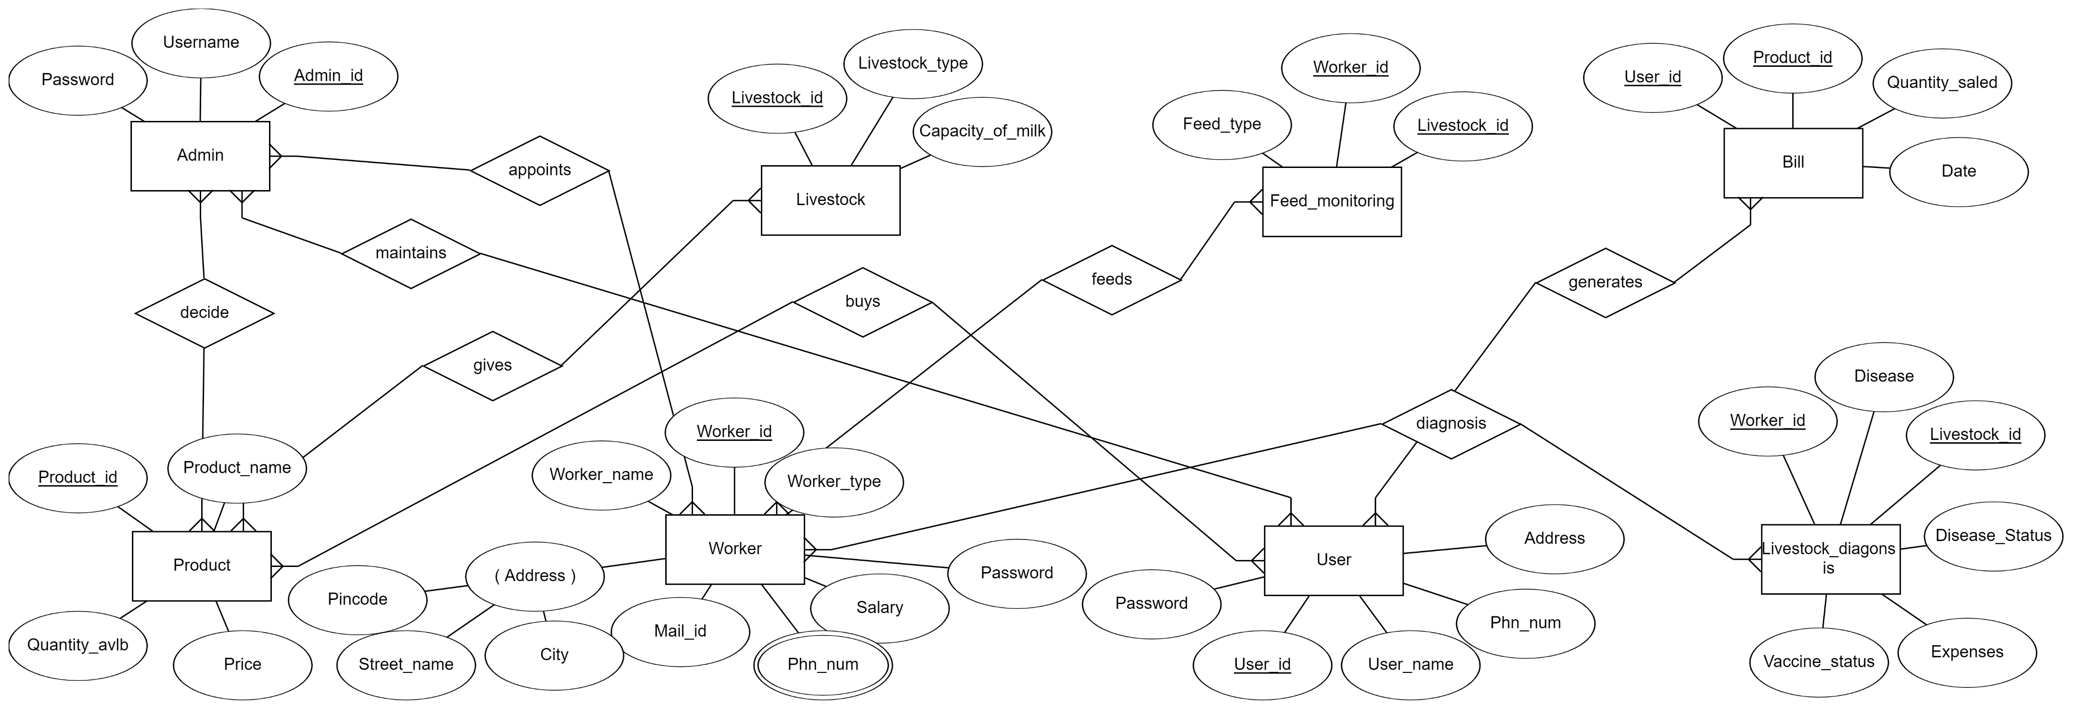

Slide 7
Schema design
ENTITES:
Admin
Product
Livestock
Livestock _ diagnosis
Bill
Worker
User

Slide 8
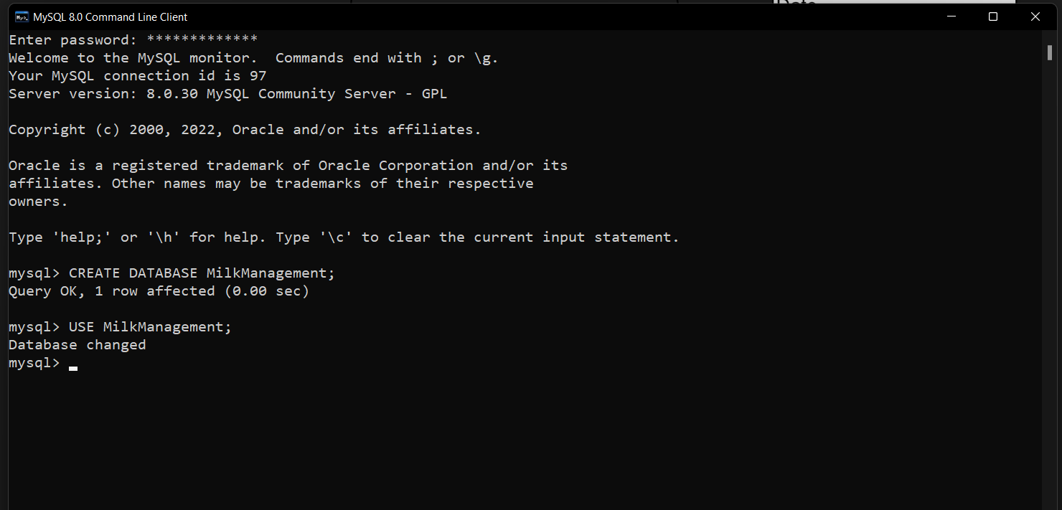

Slide 9
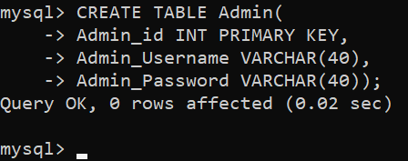
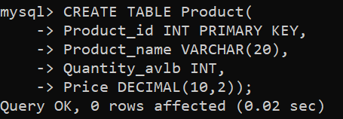
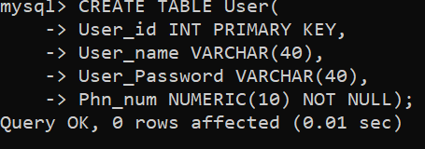
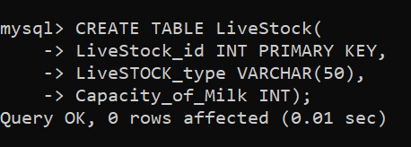

Slide 10
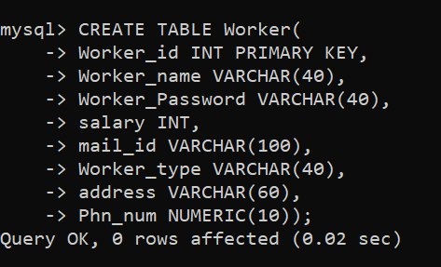
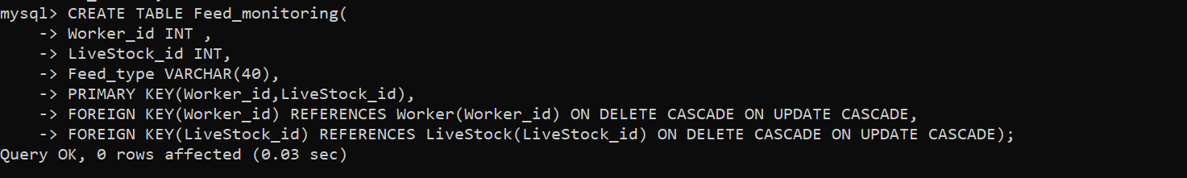

Slide 11
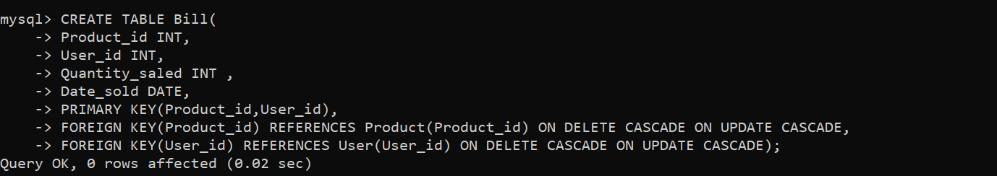
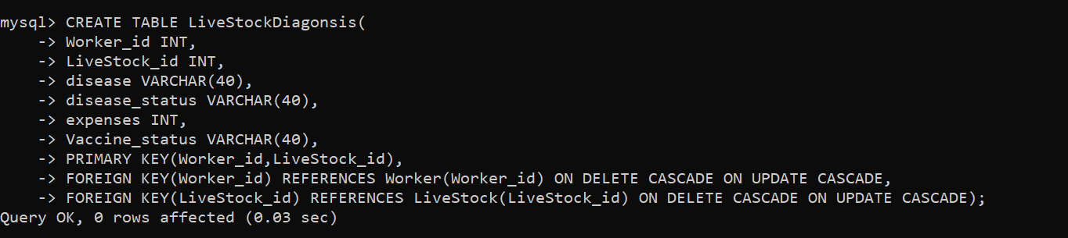

Slide 12
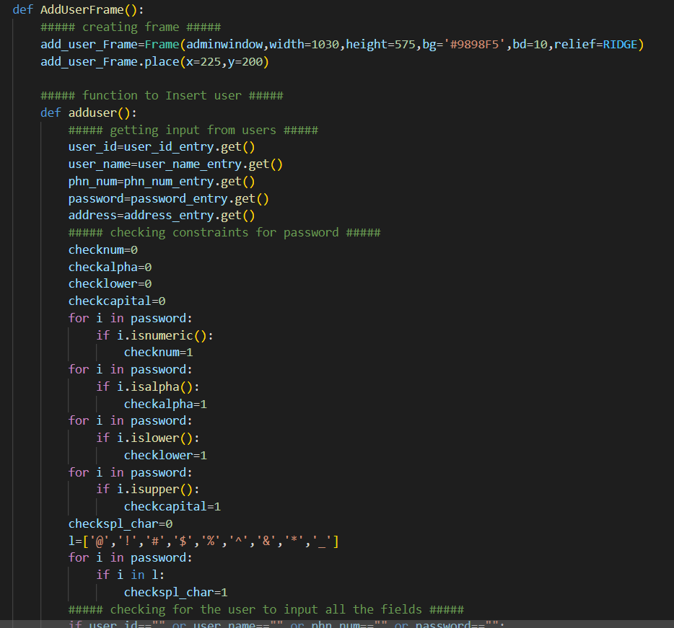

Slide 13
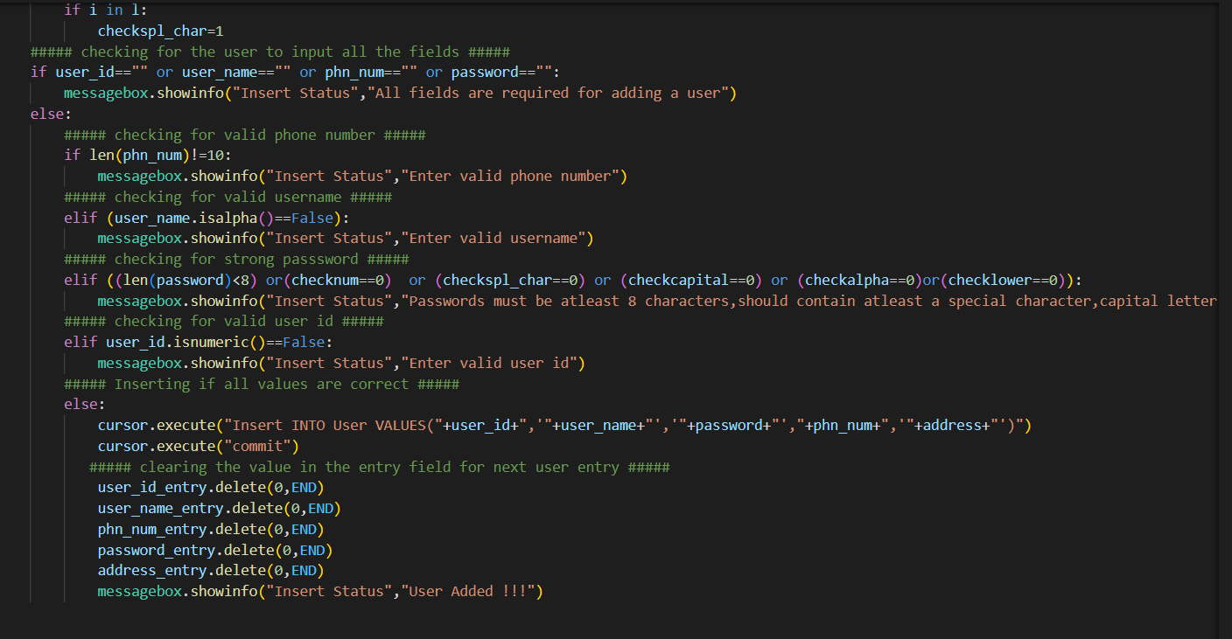

Slide 14
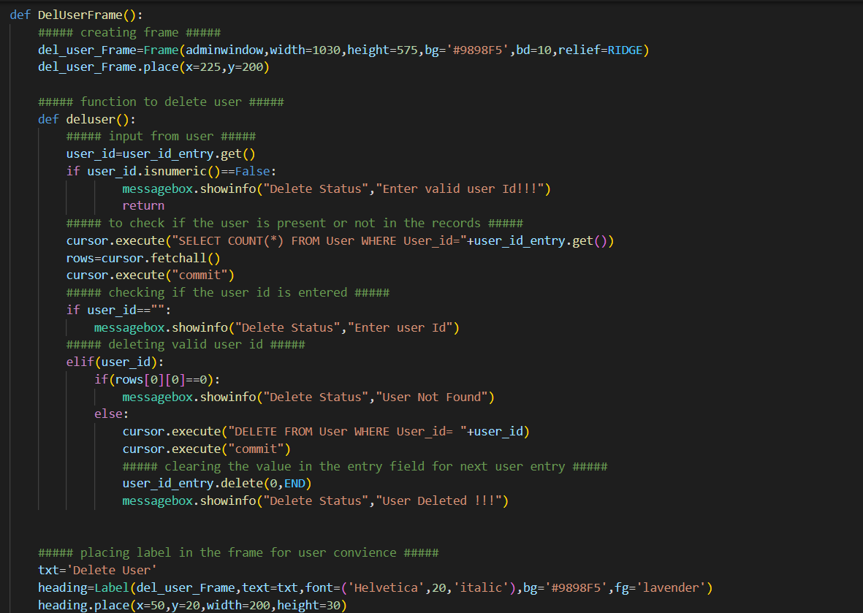

Slide 15
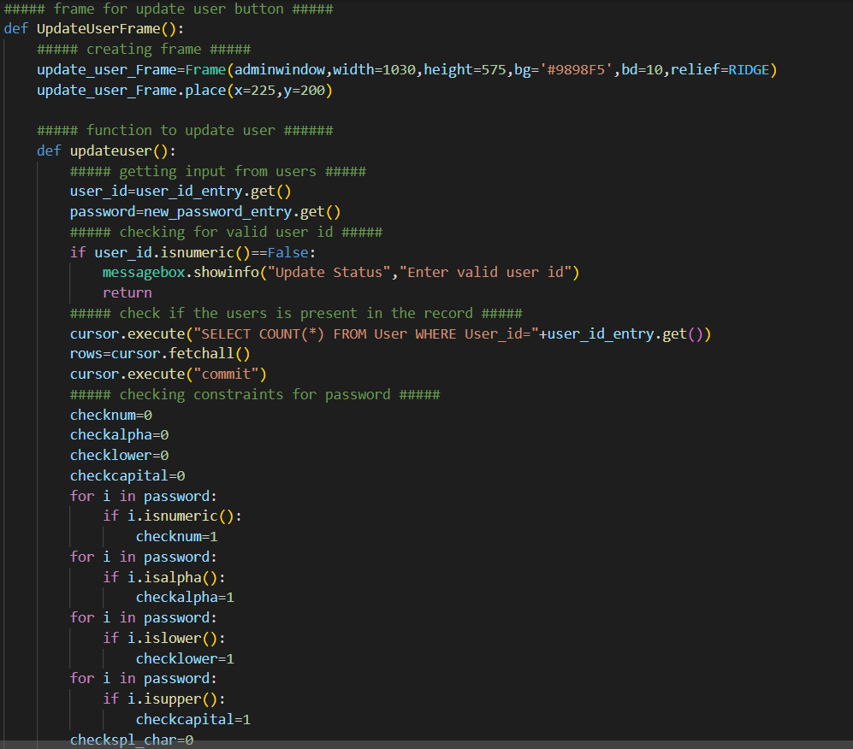

Slide 16
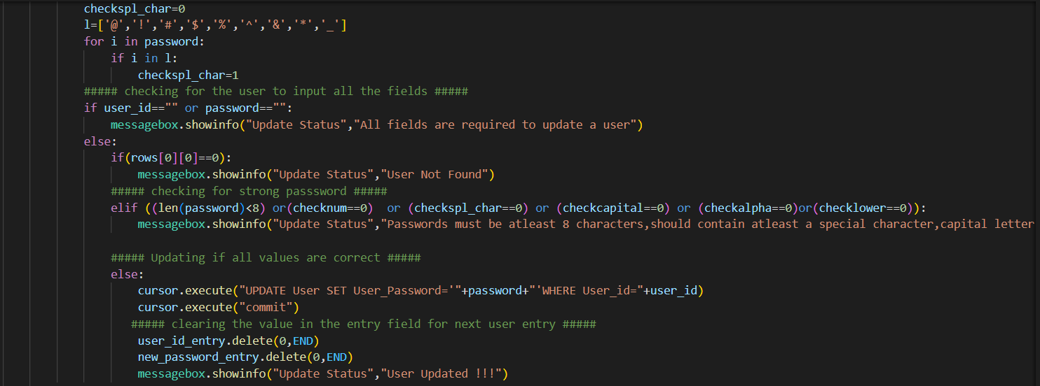

Slide 17
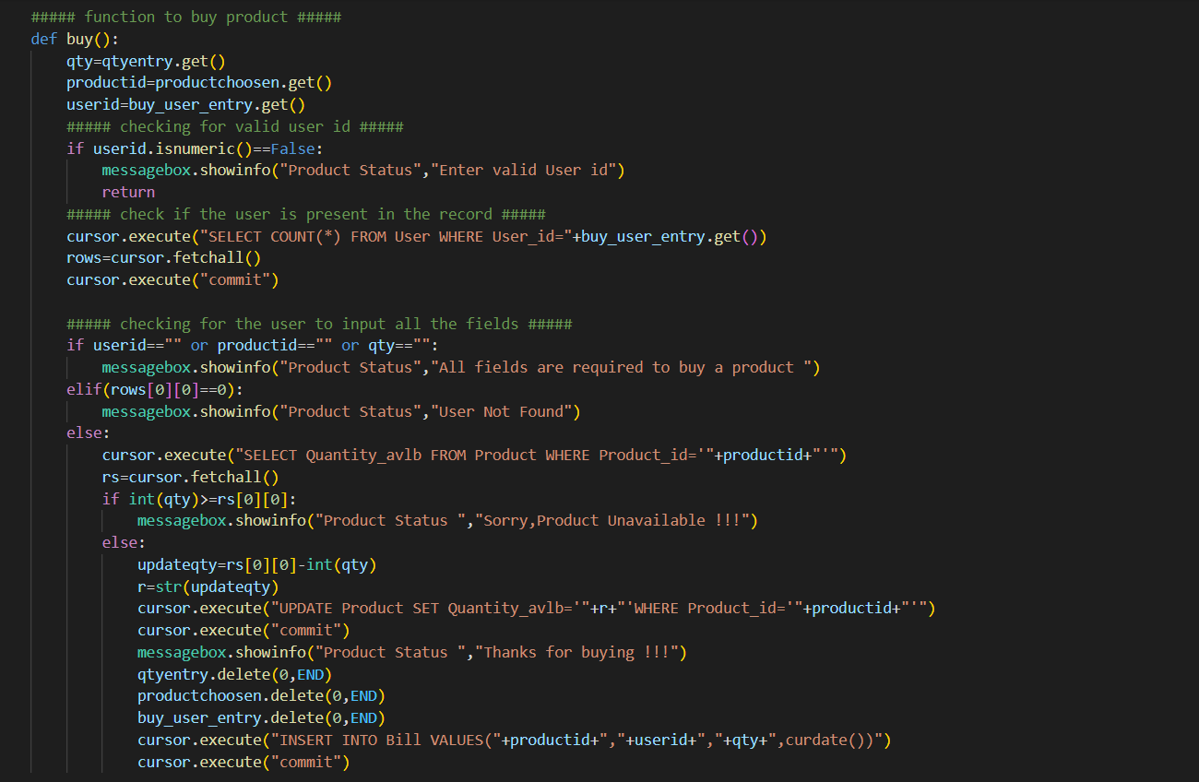

Slide 18
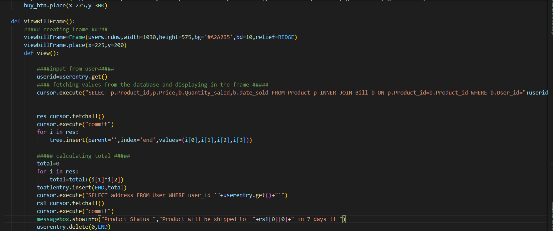

Slide 19
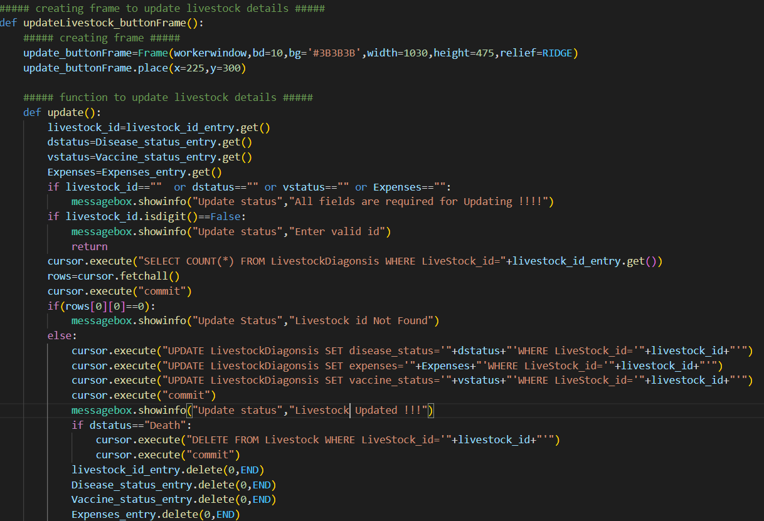

Slide 20
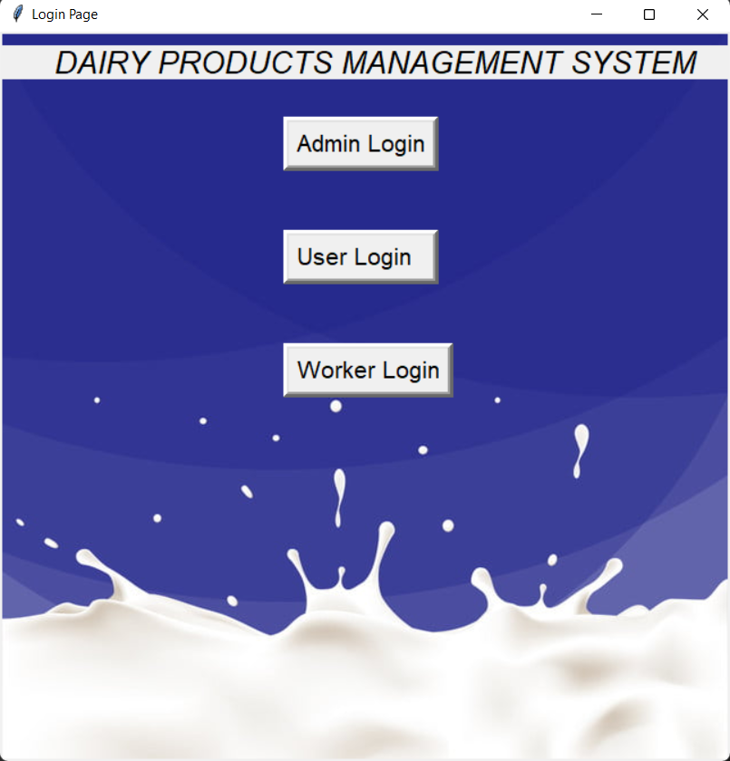

Slide 21
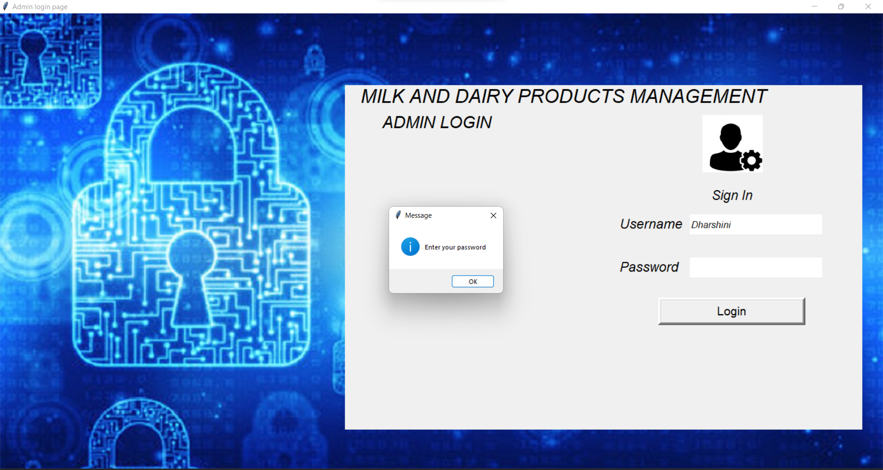

Slide 22


Slide 23


Slide 24
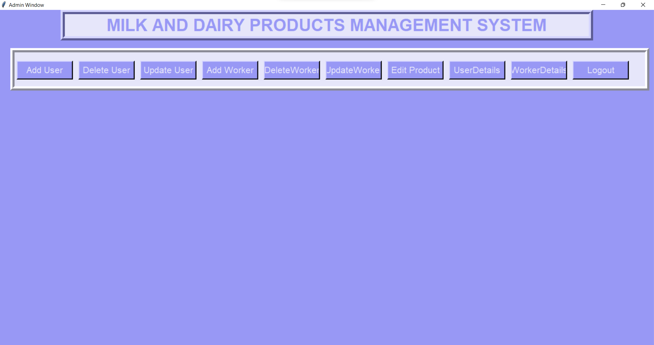

Slide 25
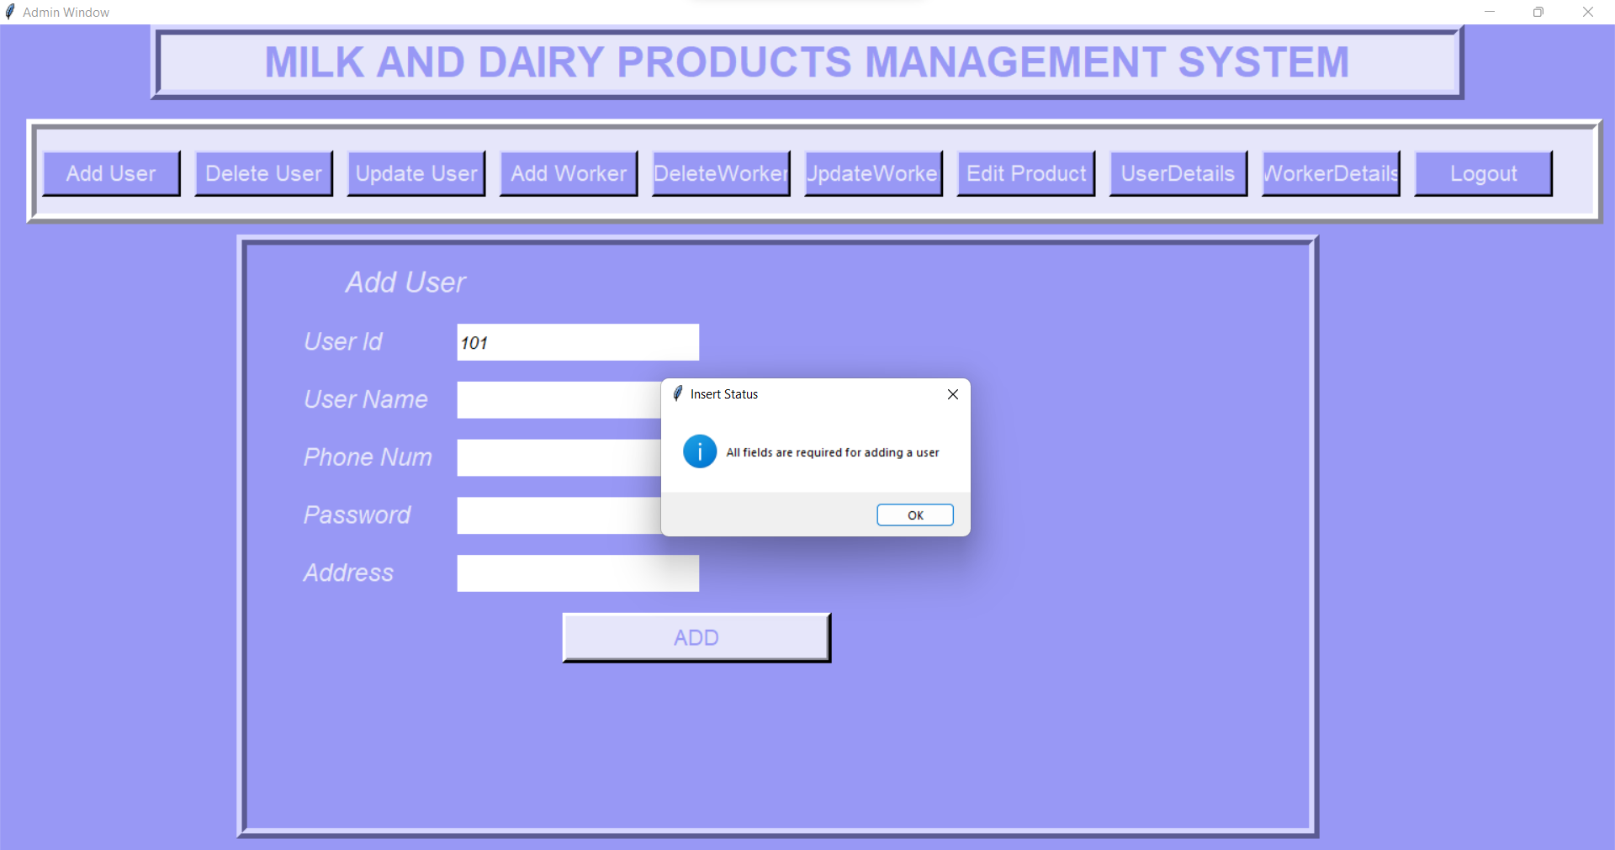

Slide 26
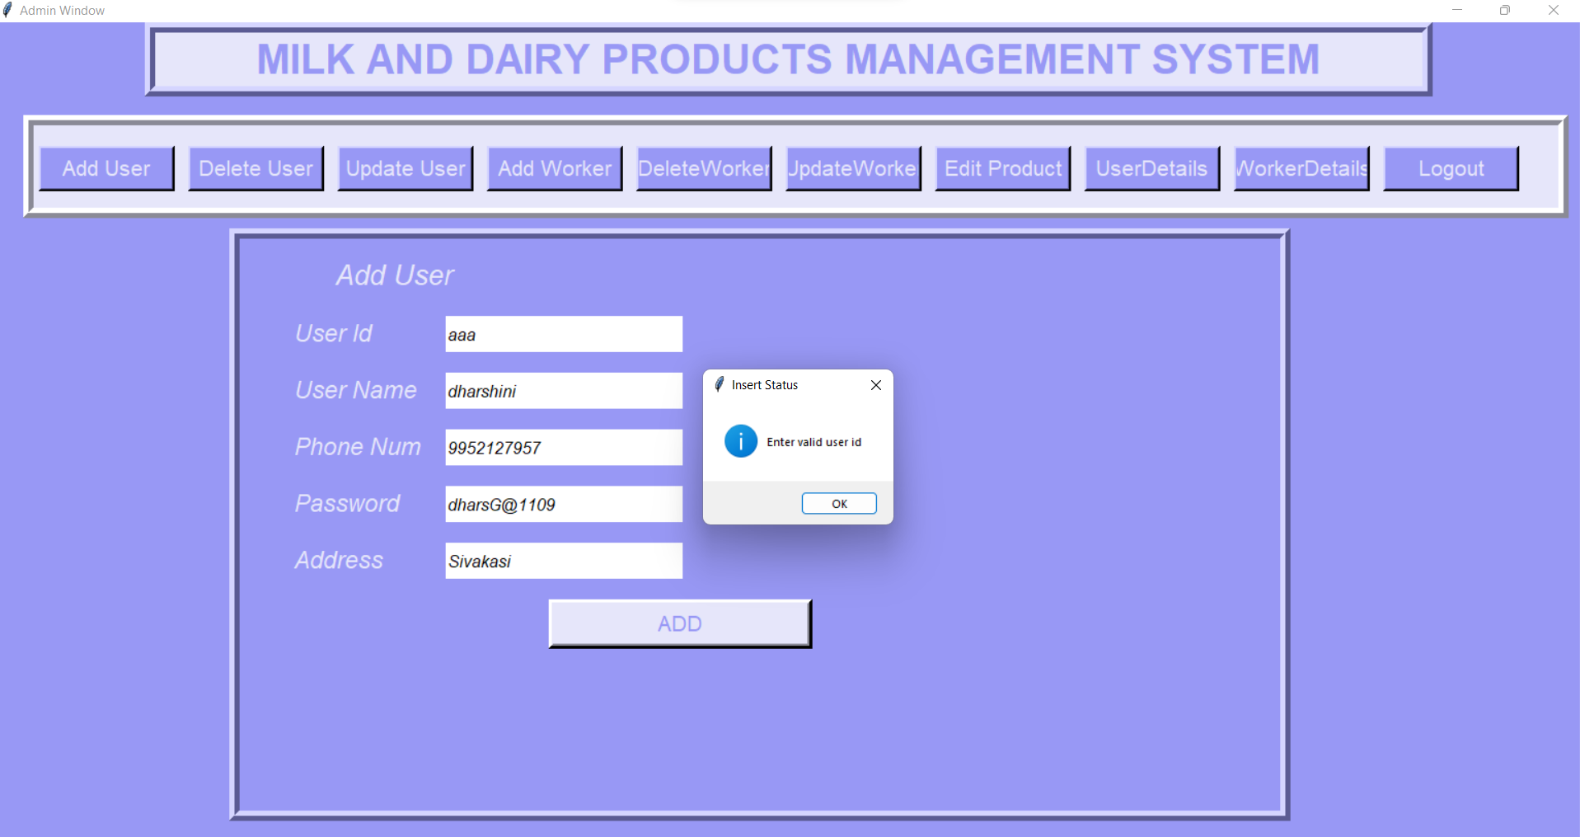

Slide 27
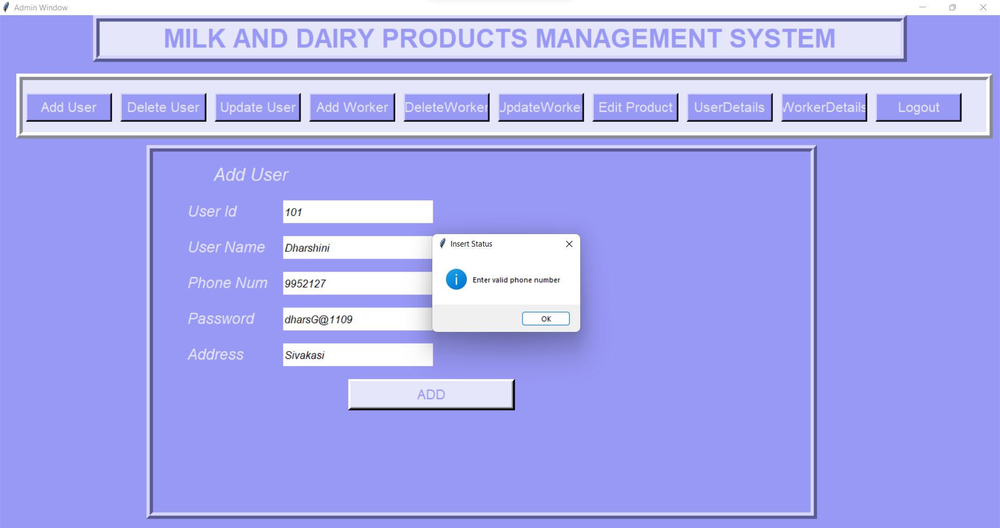

Slide 28
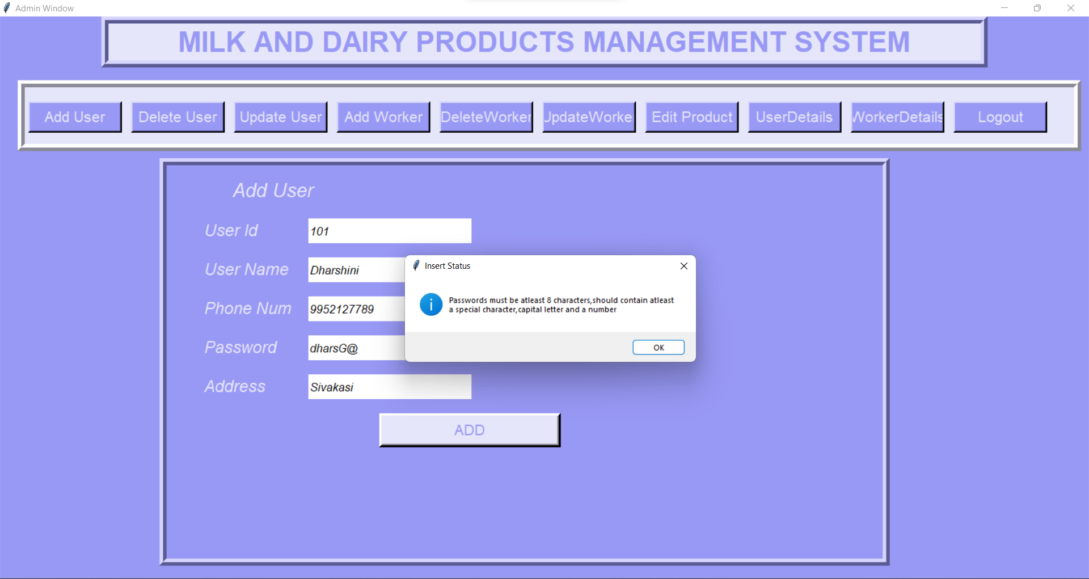

Slide 29
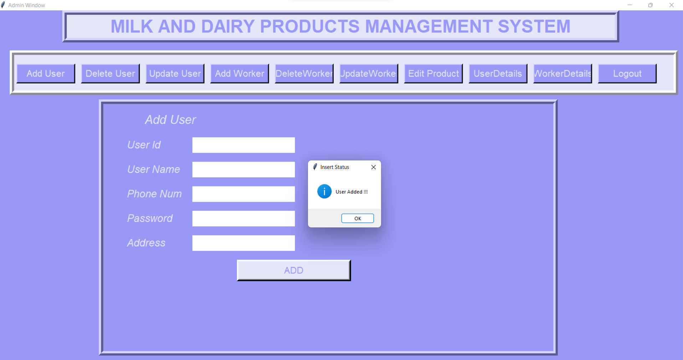

Slide 30
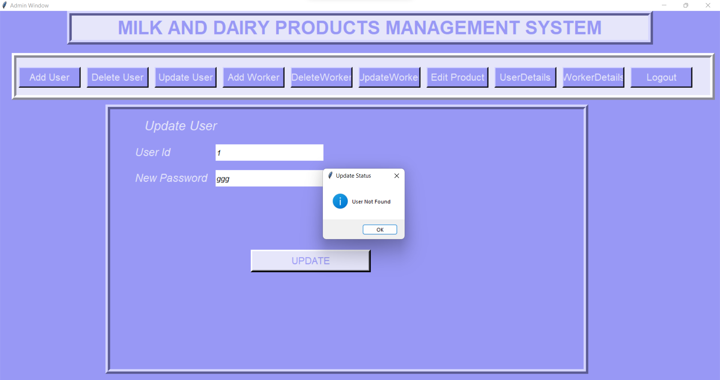

Slide 31
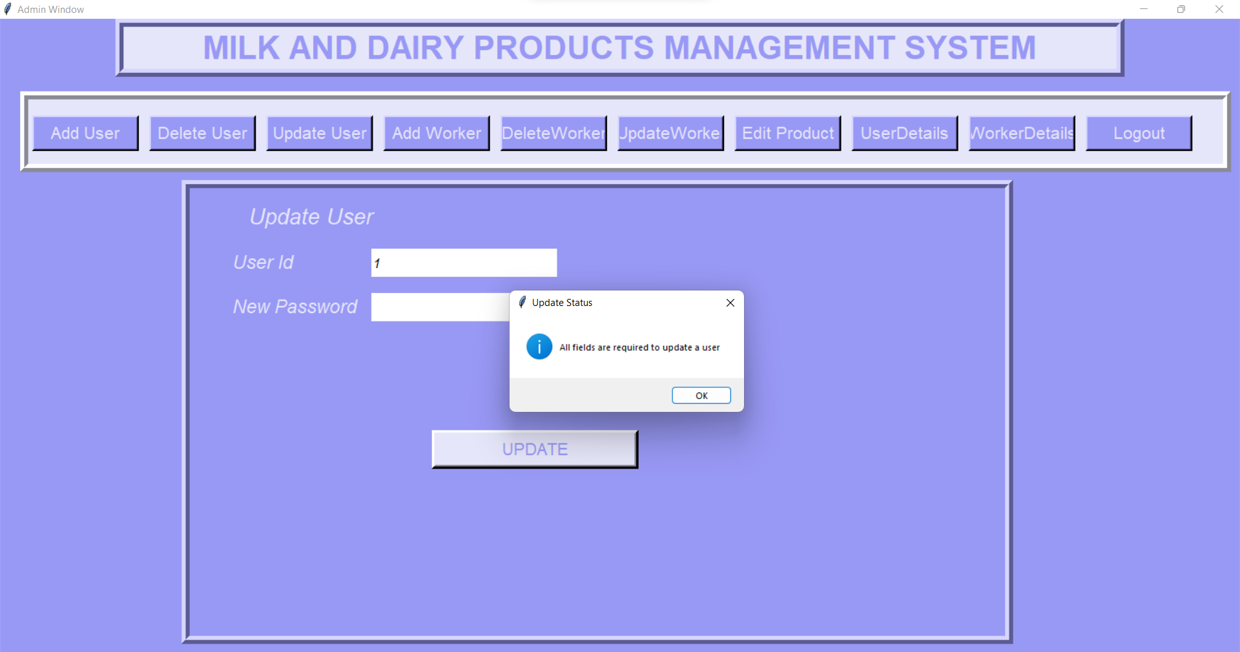

Slide 32
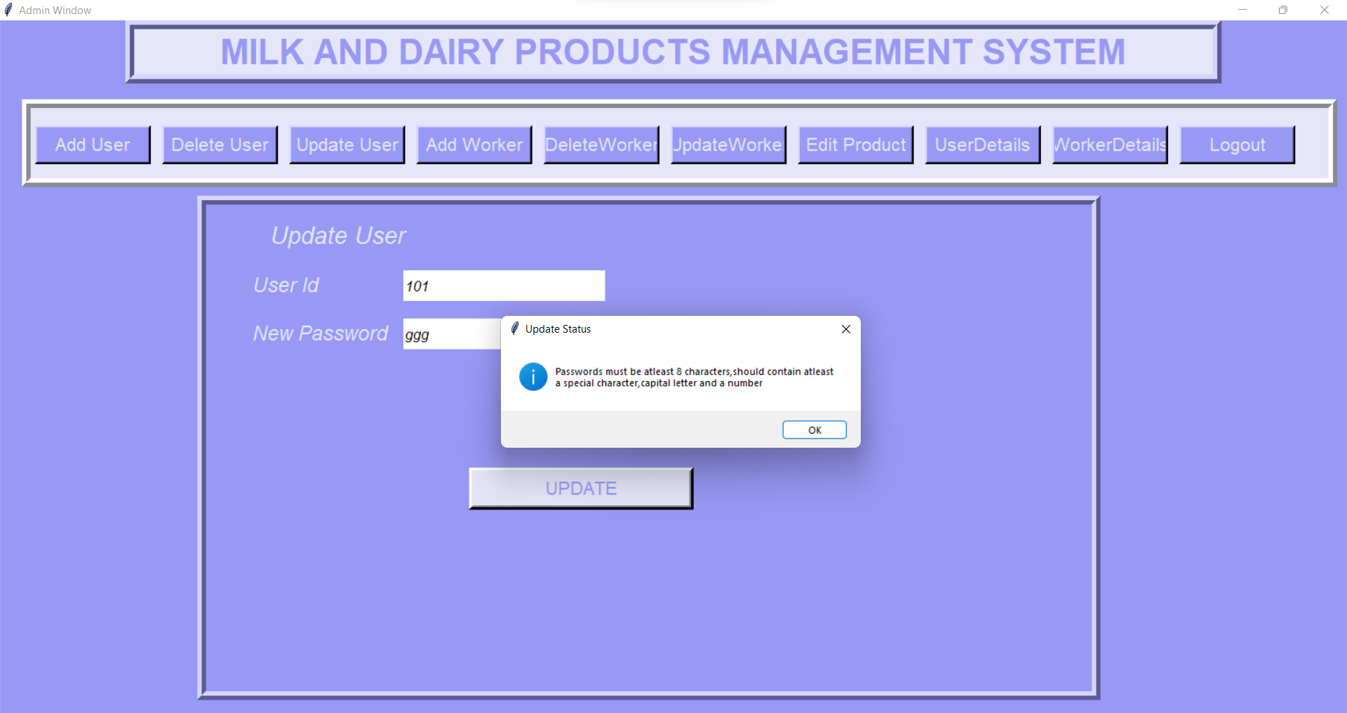

Slide 33


Slide 34
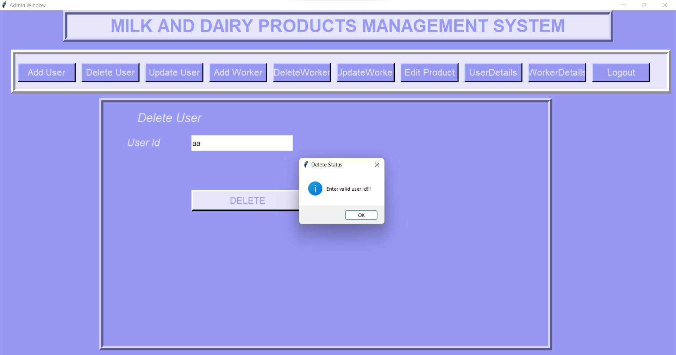

Slide 35
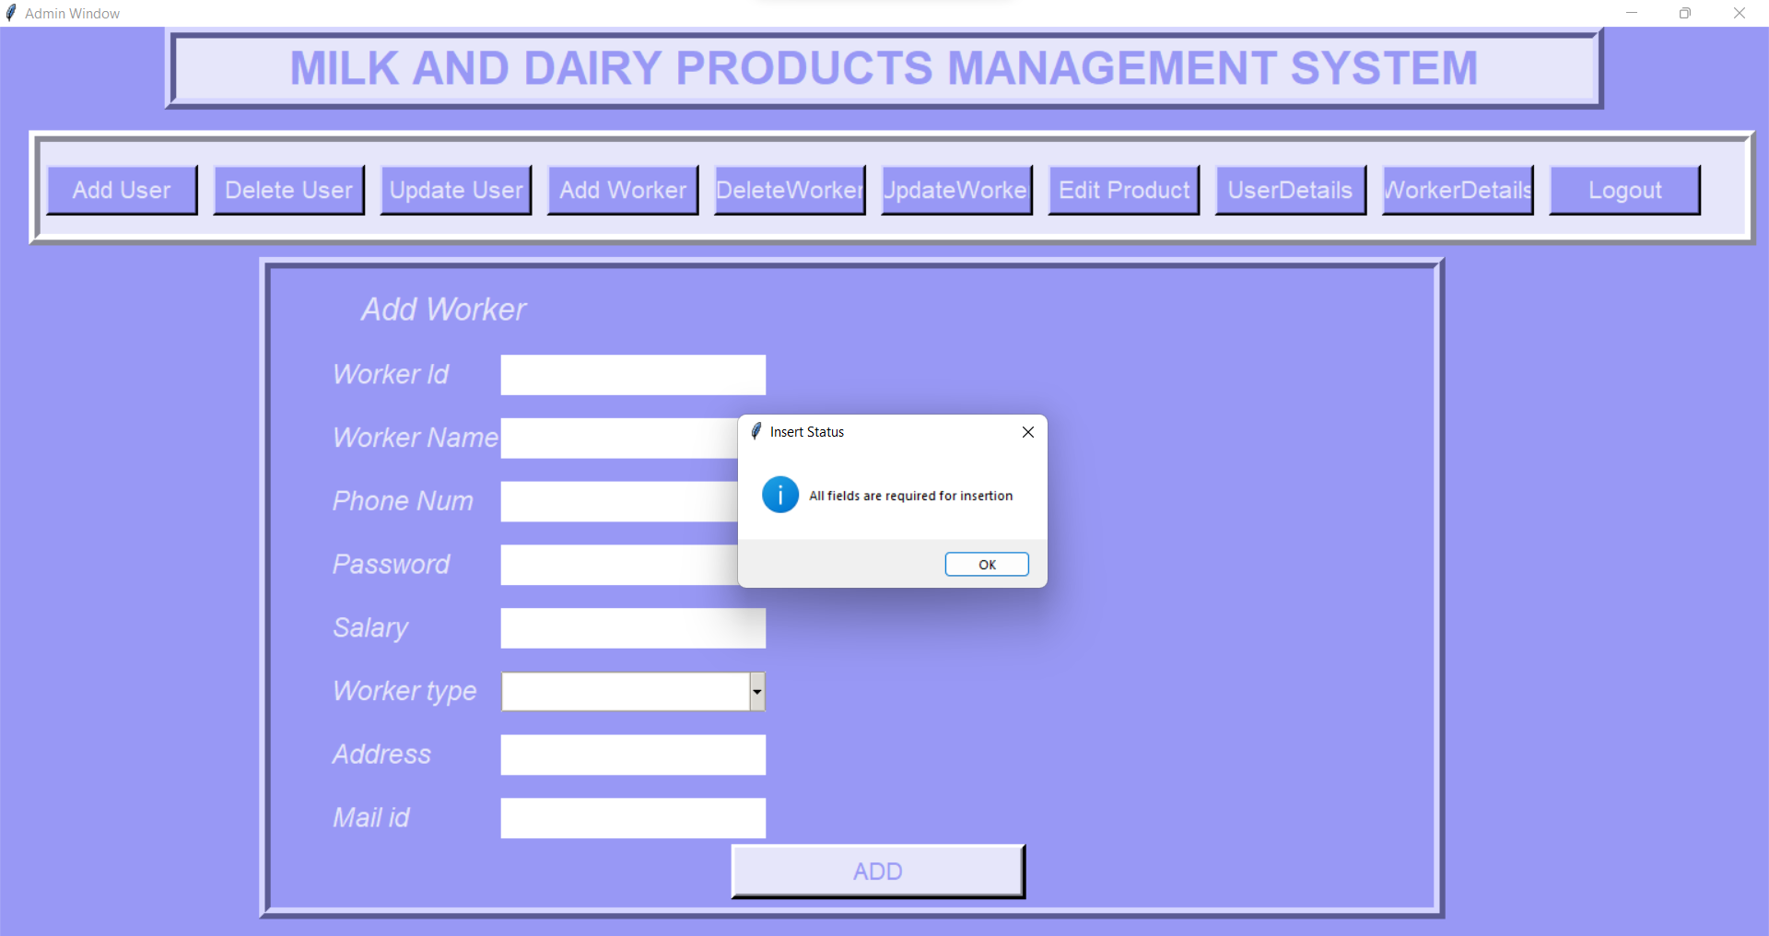

Slide 36
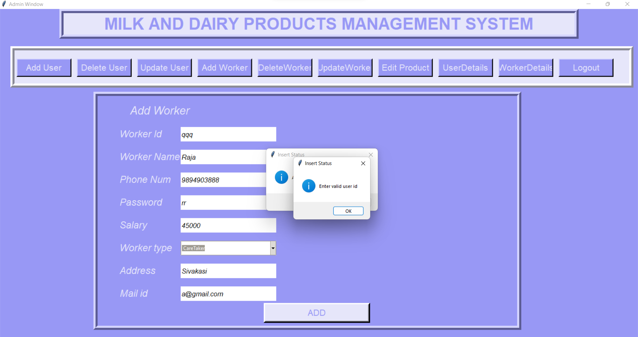

Slide 37
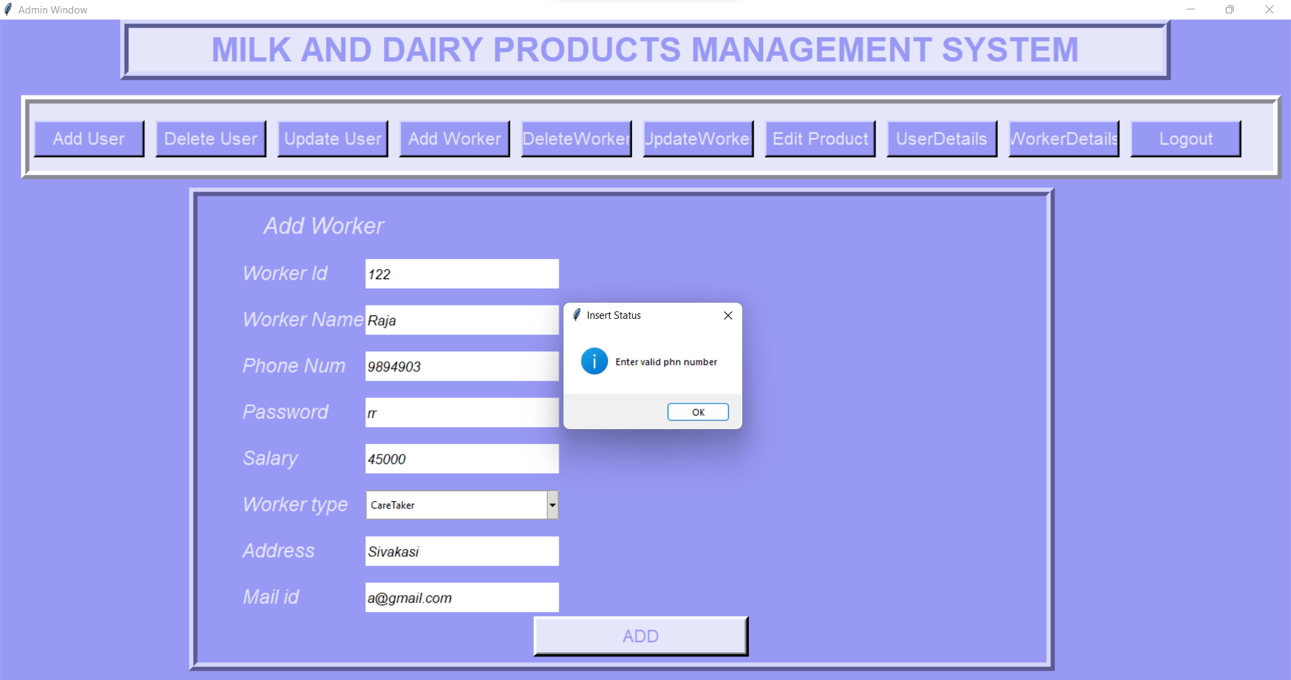

Slide 38
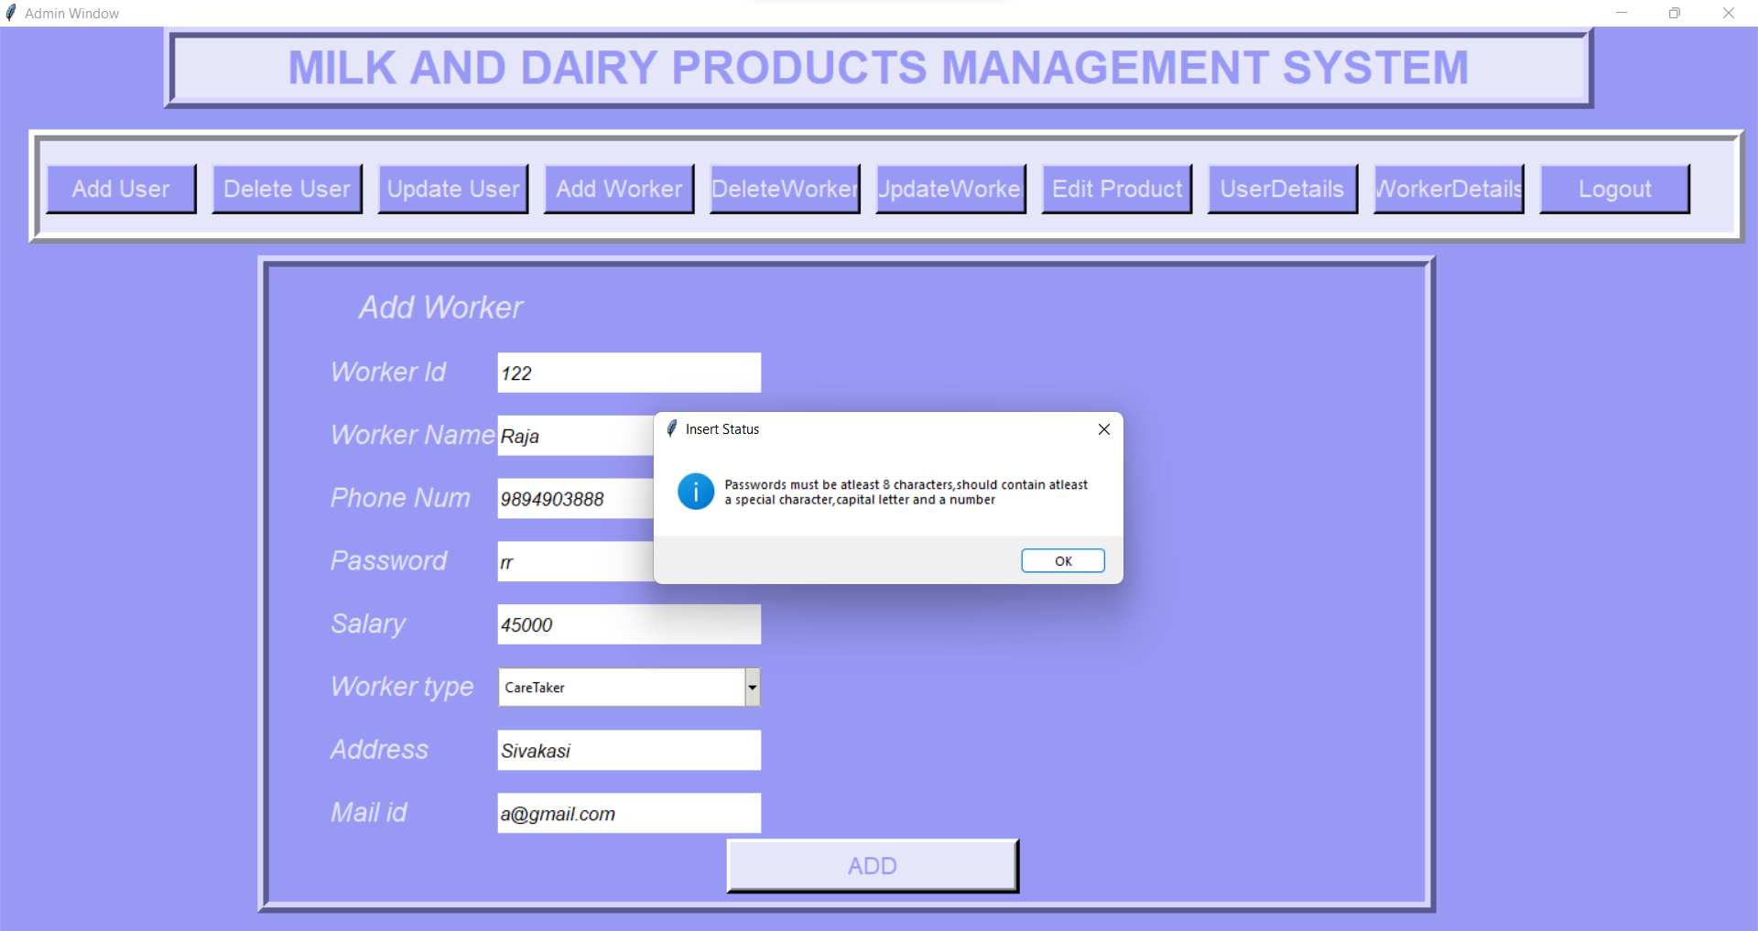

Slide 39
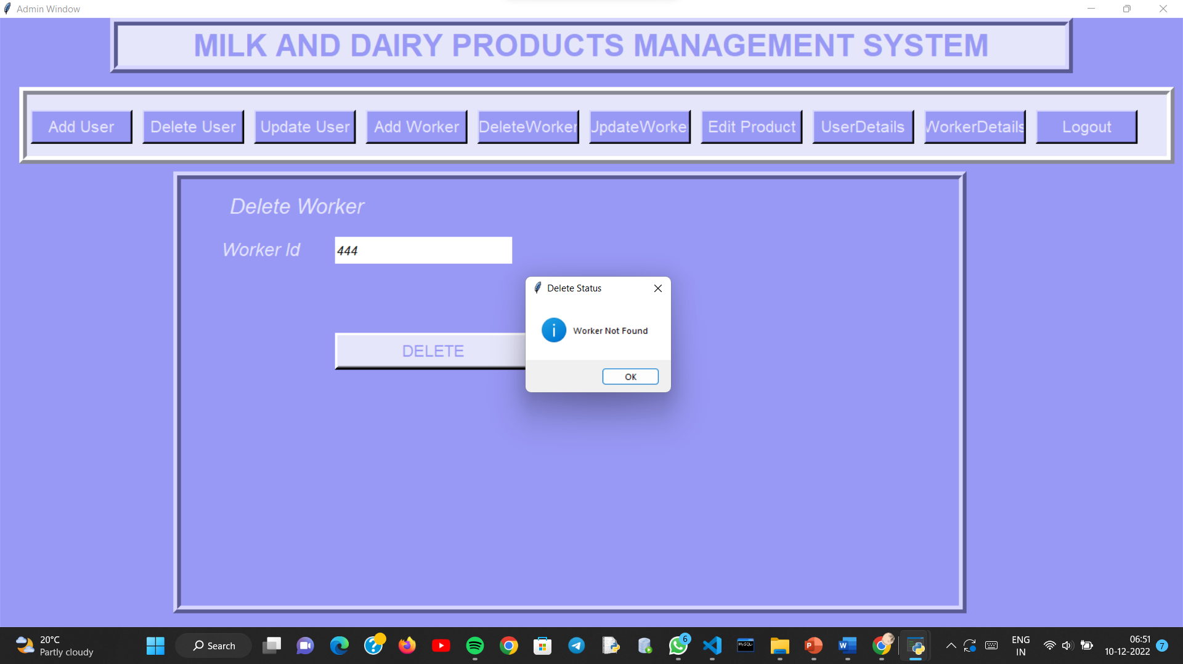

Slide 40


Slide 41
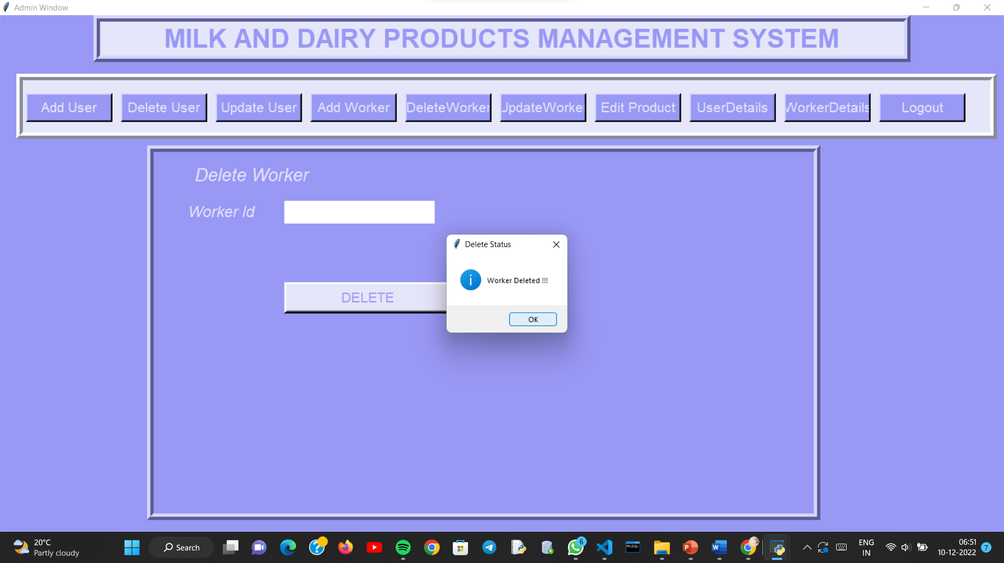

Slide 42
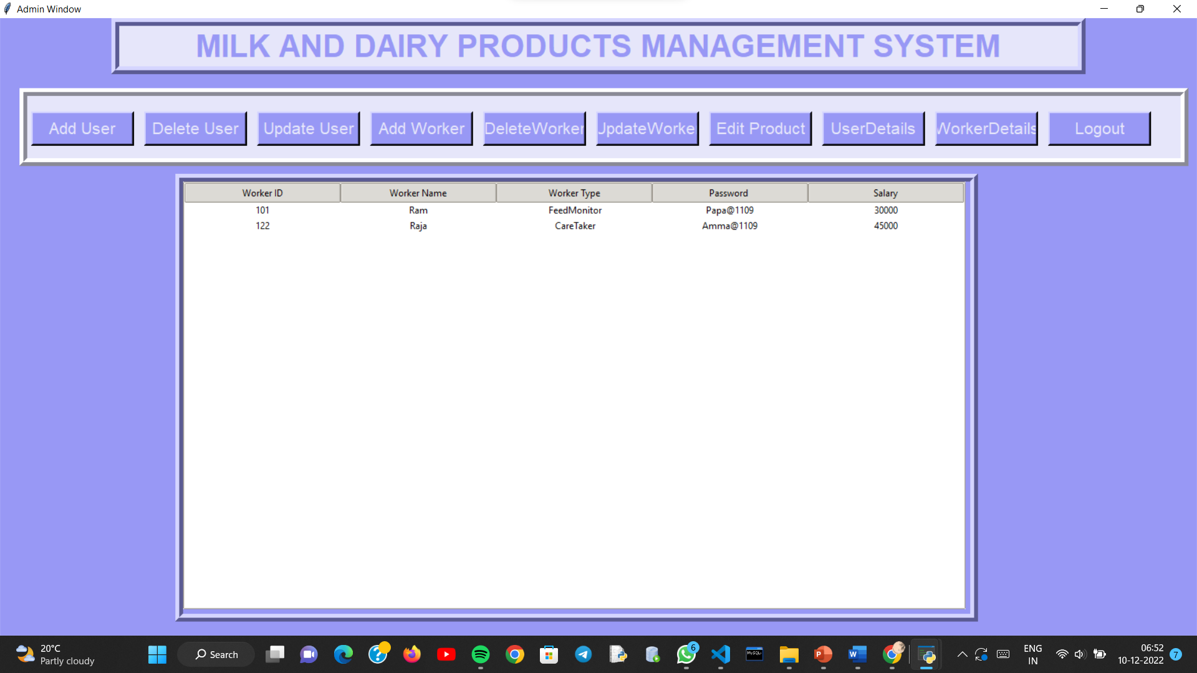

Slide 43
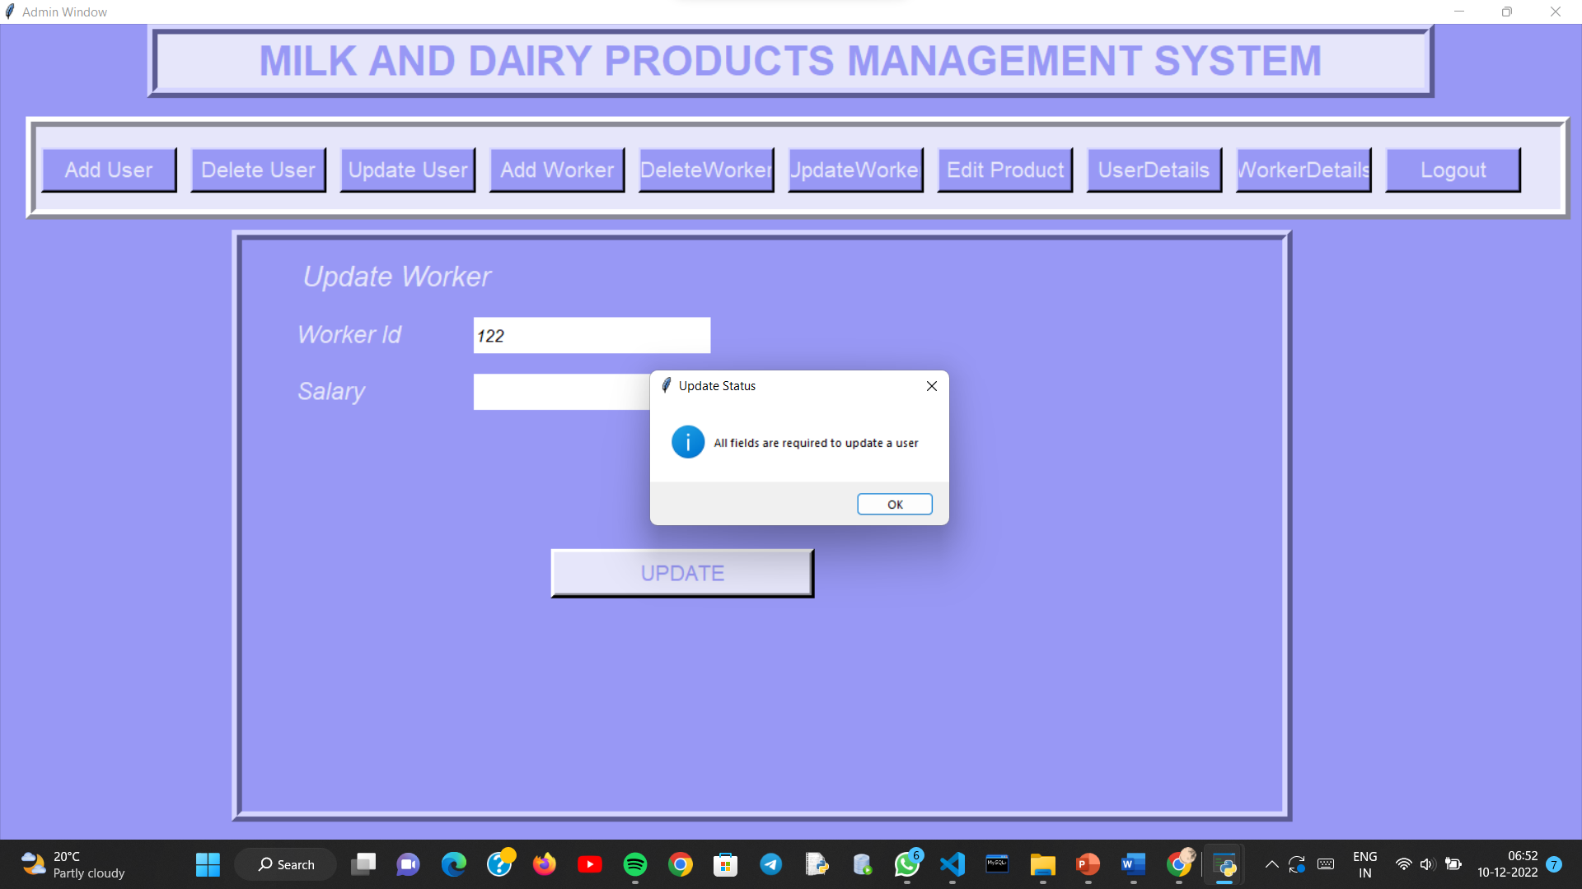

Slide 44
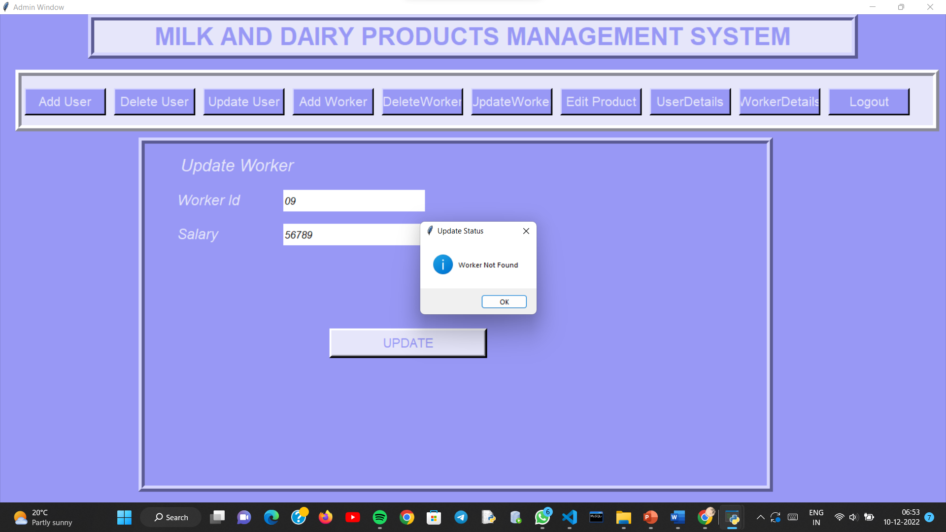

Slide 46
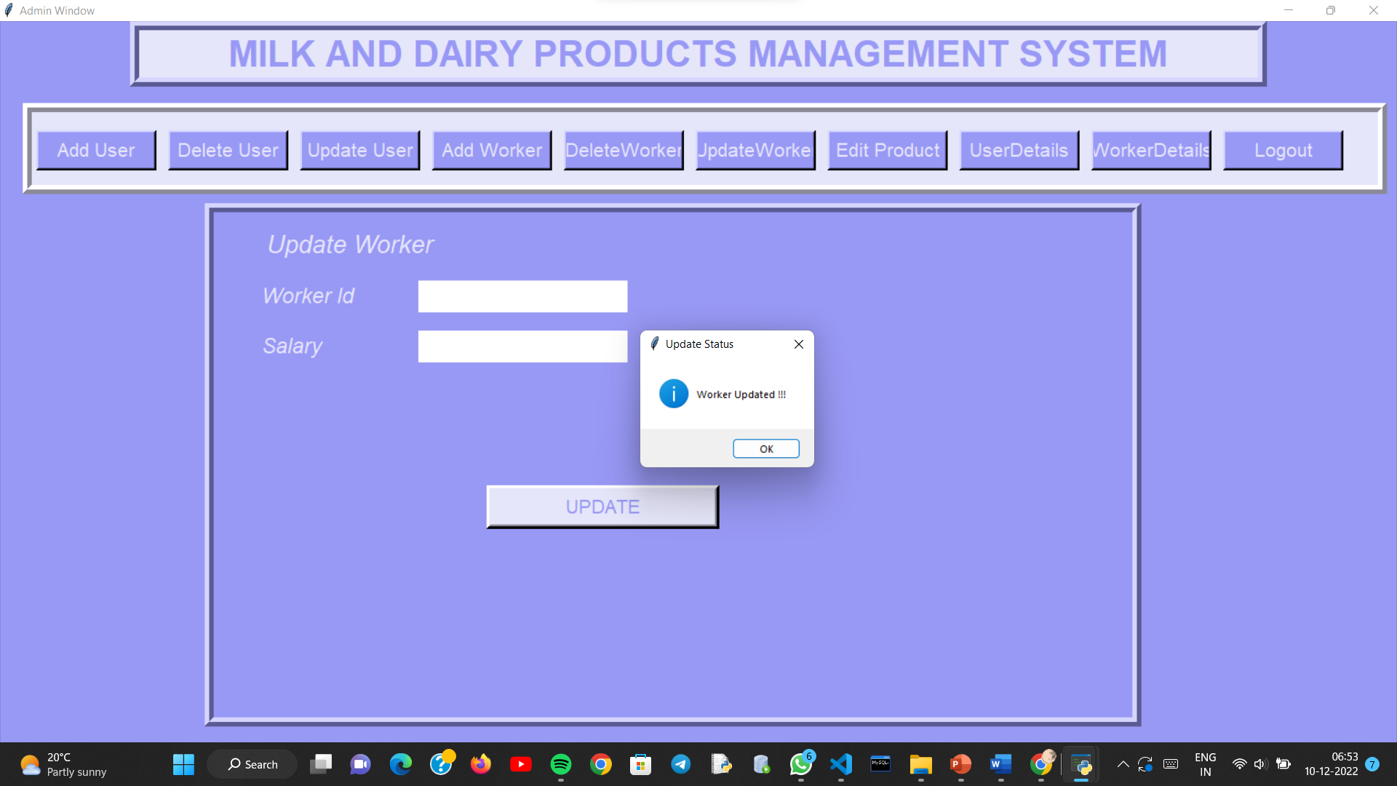

Slide 47
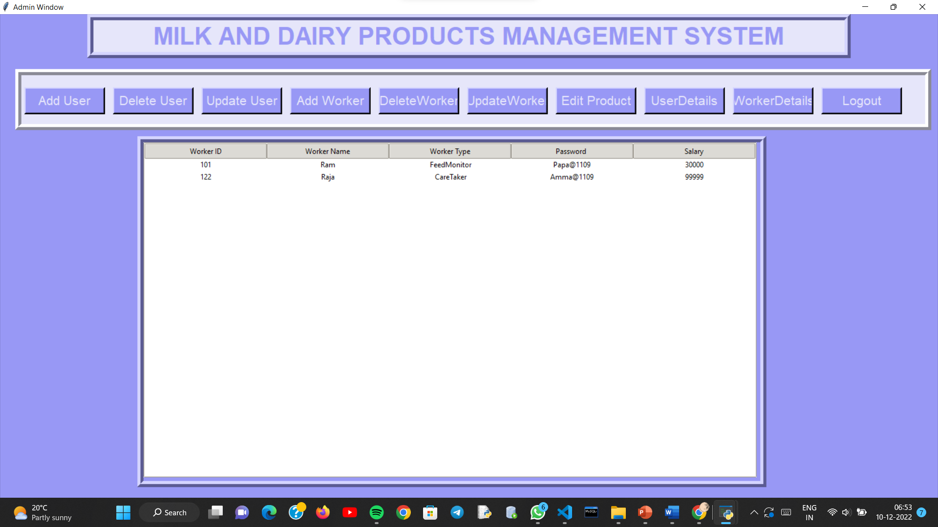

Slide 48
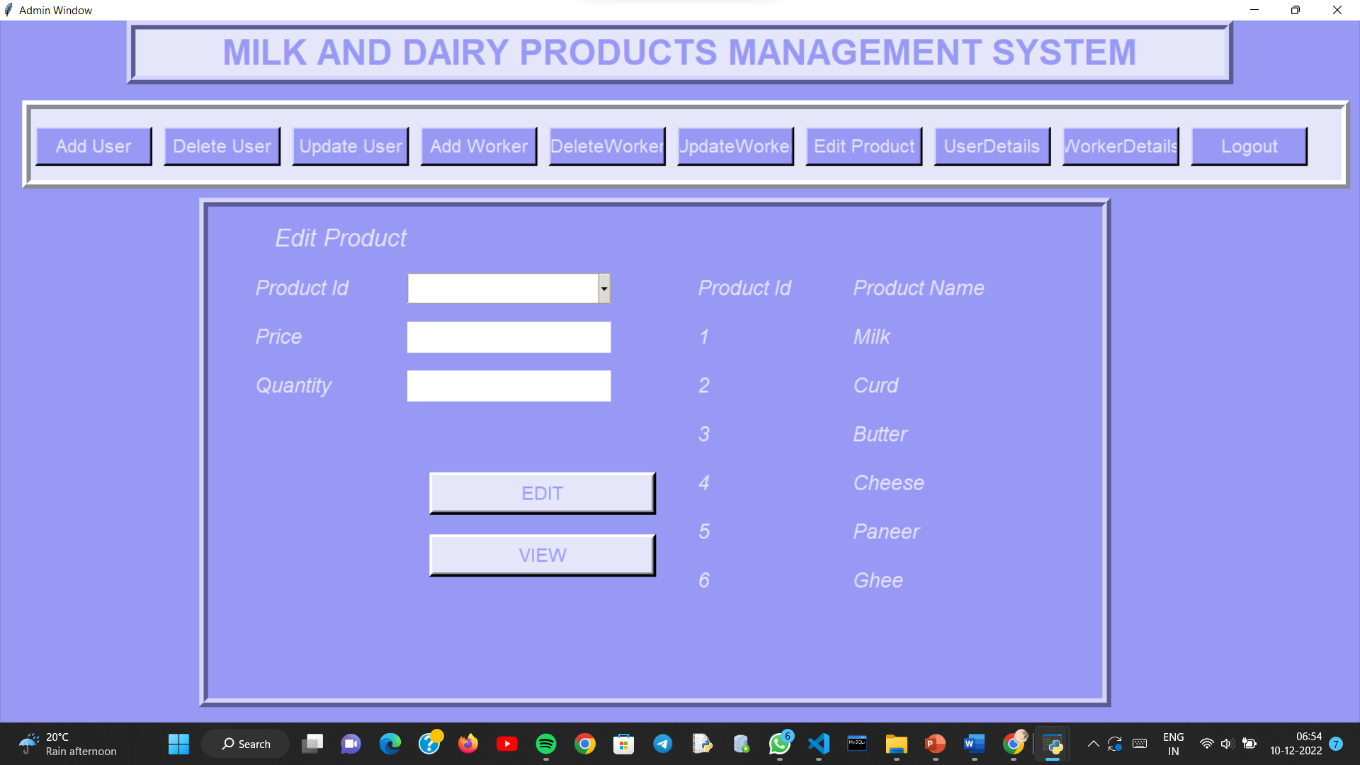

Slide 49
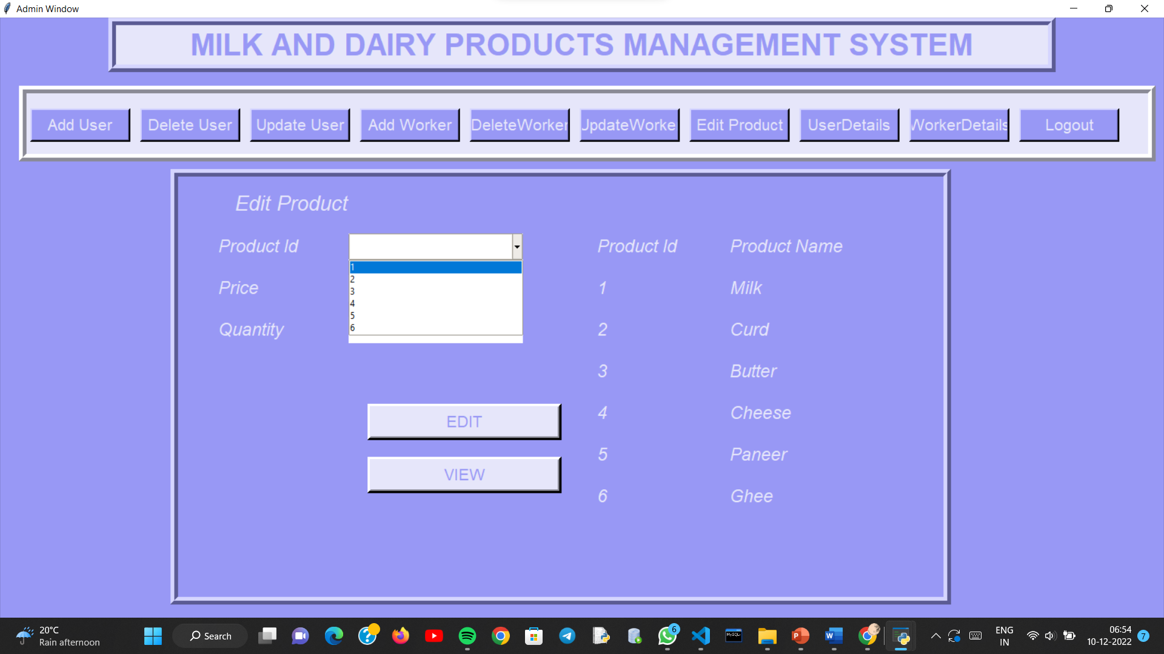

Slide 50
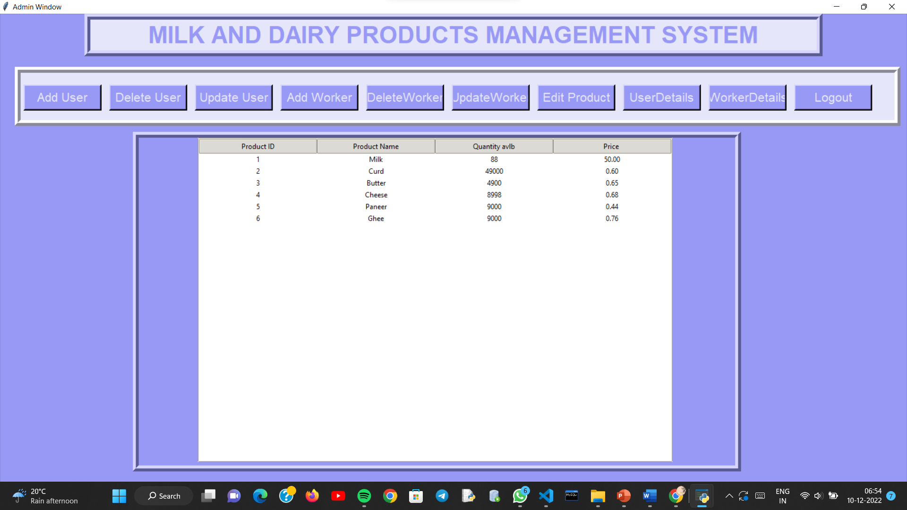

Slide 51
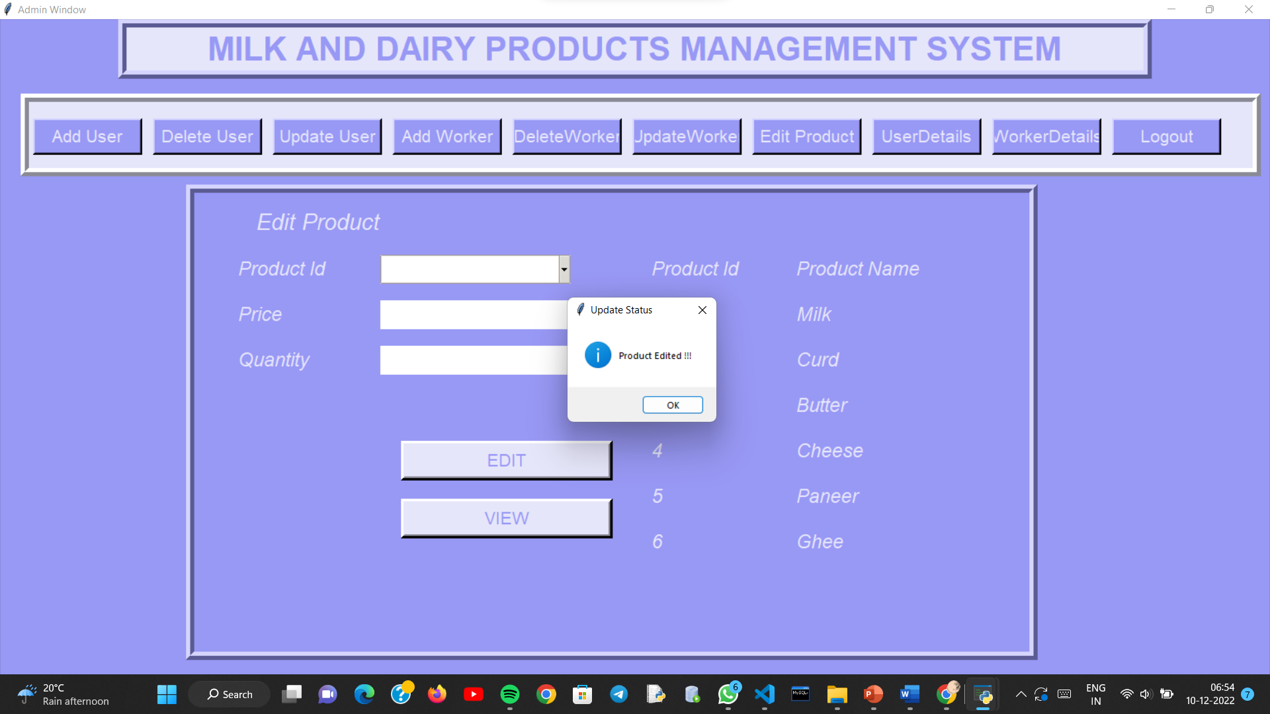

Slide 52


Slide 53
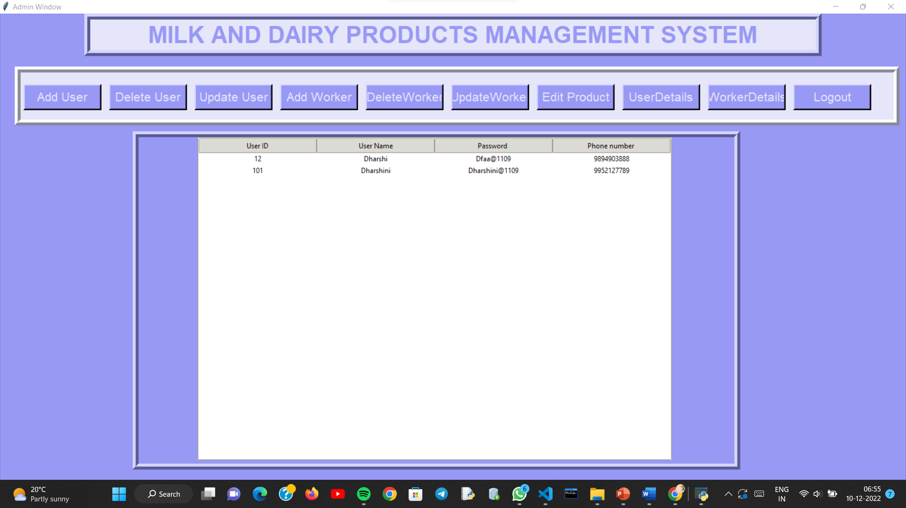

Slide 54


Slide 55
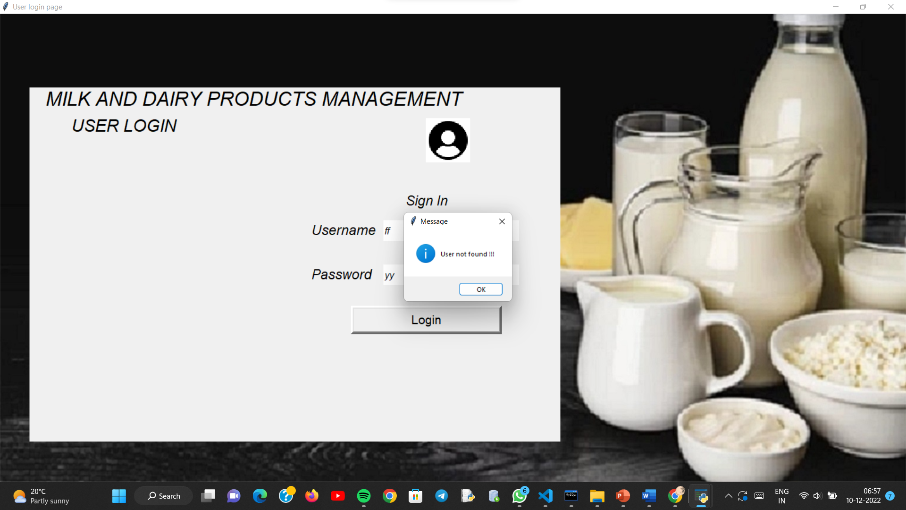

Slide 56


Slide 57


Slide 58


Slide 59
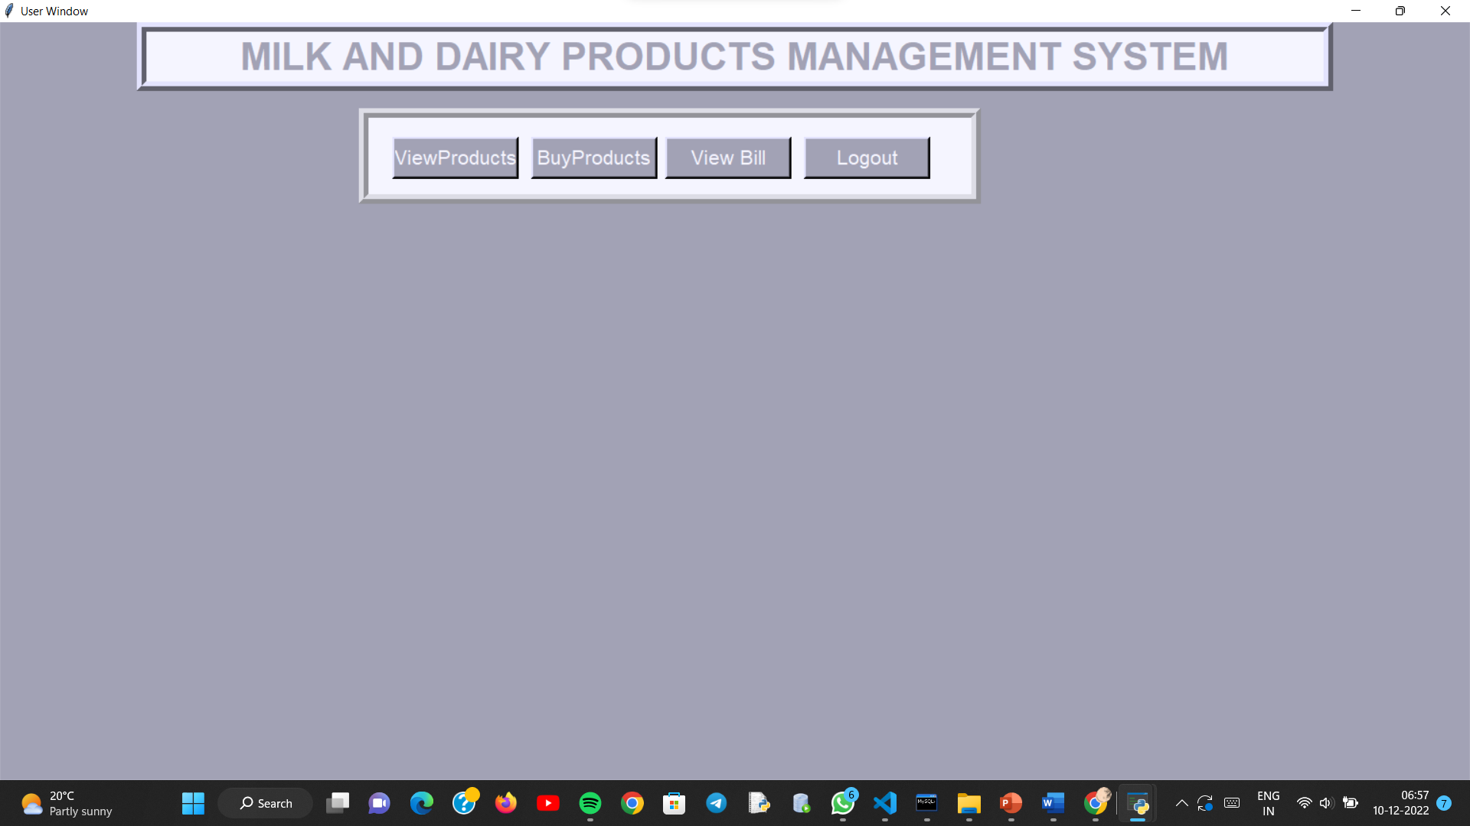

Slide 60
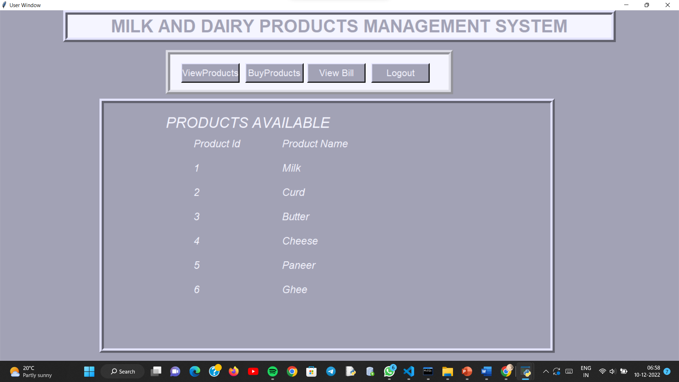

Slide 61
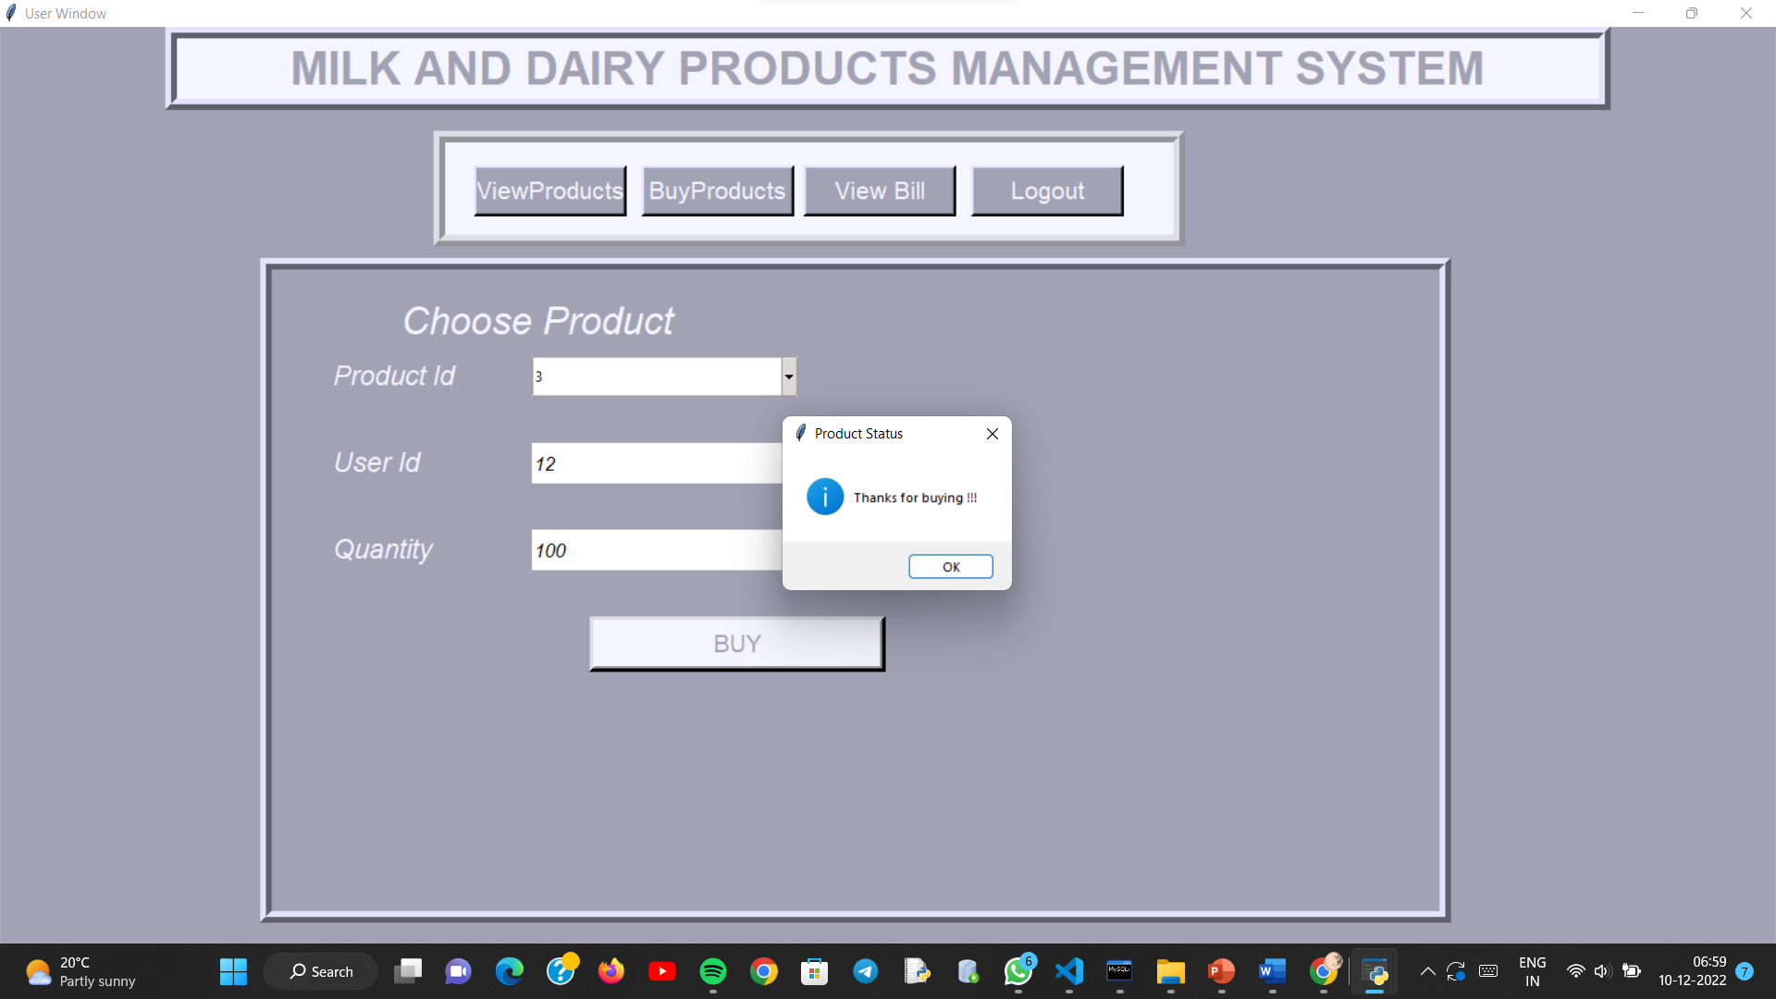

Slide 62


Slide 63


Slide 64


Slide 65


Slide 66


Slide 67


Slide 68


Slide 69


Slide 70


Slide 71


Slide 72


Slide 73


Slide 74


Slide 75


Slide 76


Slide 77


Slide 78


Slide 79


Slide 80


Slide 81


Slide 82


Slide 83


Slide 84


Slide 85


Slide 86


Slide 87


Slide 88


Slide 89


Slide 90


Slide 91


Slide 92


